Slide 1

Service Management Automation (SMA) Suite Technical Overview Training, Level 300
Carol Hibbard
You can:
Download the presentation.
Download PowerPoint slides & speaker notes.
March 2019
Notes:
Hello and Welcome to the [COURSE_NAME] Technical Overview Training, Level 300.
In this course you’ll gain a high-level understanding of the essentials of [PRODUCT_NAME].
If you want to download this presentation and save it on your own system, click the Tools & Help icon in the bottom-right corner of your Brainshark window and select Download.
Or, if you want to access the PPT slides and speaker notes for future reference, go to the Attachments tab in Brainshark and click to download the presentation.

Slide 2
Introduction to the 300-Series Curriculum
What is the 300-series Curriculum?
300
L300
L320
L340
L360-380
Notes:
[STANDARD SLIDE: L300 (animated)]
The position of the LIGHT BLUE rectangle identifies the level of the current course.
The 300-series curriculum focuses on product knowledge and experience: from foundation-level concepts to hands-on operation in a live environment.
The curriculum spans Level-300 courses all the way through Level-380 courses.
[PRESS ONLY ONCE AS IMAGES APPEAR ACROSS THE SCREEN] The Level-300 course is the FIRST step in the 300-Series training curriculum.
It provides a foundational overview of the suite without diving deeply into individual product capabilities and operation.

Slide 3
About this Course
SMA Suite
Components & Editions
Key Takeways
Recommended Pre-Study
Certification
Take the certification exam
L110 to L150
L210 to L240
What are the SMA Components?
Capabilities
Relations
SMA customer challenges and key outcomes
SMA capabilities
SMA Suite editions and licensing structure
SMA differentiators
What are the SMA customer challenges and key outcomes?
What is the SMA Suite?
What are the SMA Suite editions?
Who are the SMA competitors?
Notes:
[STANDARD SLIDE: Customize according to your course]
The number of rectangular items varies according to the course; however, “Certification” is always the last item.
The contents of the rectangular items will vary based on the topics in your course.
ALL Slide Note text for this slide should be customized to suite your course.
Here is what you need to know about the [COURSE_NAME] Level-### course:
[PRESS] First we provide a quick overview of the [Name] Suite and customer challenges.
[PRESS] Next, we look at each product in the suite: 1, 2, and 3. We also examine the different editions of the suite.
[PRESS] Last, we focus on competitive differentiators.
[PRESS] We recommend you complete the [NAME] course BEFORE you take this course, .
[PRESS] After you finish this course, you will take a certification exam!
[PRESS] There are even some short interactive quizzes to keep you focused!

Slide 4
What is the SMA Suite?
SMA customer challenges
Micro Focus’s SMA solution
Key outcomes

Slide 5

Service Management Challenges
Slow and unresponsive Service desk
Inadequate or limited self-service
Too many manual tasks
Long deployments and costly upgrades
Unknown asset usage
Dissatisfied users bypass the service desk
Proliferation of shadow IT and LOB initiatives
Low service quality at high cost
Painful service desk projects with high costs
Overspend on assets or compliance risk
Notes:
Emerging trends and today’s explosion of new technologies are rapidly changing the expectations of the business, IT, their users, and customers. Increasing complexity, the demand for continuous operations in an agile world, and dynamic modern workloads put IT under pressure to move at the speed of DevOps. IT must support more services, more devices and at the same time become faster and more agile – all within challenging budget frames.
But reality is different ...
The perception of being slow and unresponsive leads to dissatisfied users who bypass the service desk
Inadequate or limited self-services result in a proliferation of Shadow IT and LOB initiatives
Too many manual, error-prone tasks lead to low service quality at high cost
Long deployments and expensive upgrades cause painful service desk projects, exceeding time lines and budget
Unknown asset usage, for example over- or under-provisioning of licenses, entails overspend on assets and compliance risk

Slide 6
Service Management Automation
Innovative architecture, built for agility and scale
Machine learning and analytics based service desk
Smart self-service with social collaboration
Modern user experience for enterprise applications
Codeless configuration and easy upgrades
Containerized ITOM platform with flexible deployment options
Multi-tenancy support for internal and external service providers
Mobile
Chatbots
Smart Email
Portal
SMAX Studio
ITSM
ITAM
ESM
Automation & Orchestration
Machine Learning & Analytics
Configuration Management
Discovery
ITOM Platform
Physical
Virtual
Cloud
Container
Notes:
[NOTE: Some of the capabilities described here are only available with SMAX. See slide 16 for details]
As discussed before, today’s IT service desks are complex and costly: slow responses, frustrated users who bypass the service desk, manual processes, high maintenance effort and no choice of deployment. How can Service Management Automation help with this situation?
SMA is the first application suite for IT Service Management, IT Asset Management, and Enterprise Service Management built on a single platform, based on machine learning and analytics, and integrated with CMDB and Discovery. Built on container technology, it can be deployed anywhere (private or public cloud). Its scalable multi-tenant architecture with deployment either on premise or cloud makes it easy to install, configure, and run.
Service desk built upon analytics and machine learning provides capabilities like Smart Ticket, which uses an Optical Character Recognition (OCR) and machine learning system to automatically accept and route service requests. Virtual agents provide automated assistance with integrated live-chat or email to enhance continuous customer support. Hot Topic Analytics uses advanced search and analytics capabilities to enable you to view and analyze patterns in incidents, requests, and other records and to create knowledge articles or problem records based on those patterns. Change Analytics feature offers insights based on the available data, and suggestions for improvements in change management. Collaboration via ChatOps allows to share knowledge across teams for fast issue resolution.
Smart self-service with social collaboration Social collaboration features including ability to vote, "ask a friend," or survey to help end-users source answers from the community and enhance end-user autonomy. On-the-fly translation provides end users with access to portal content and service desk updates in their preferred language: Native mobile applications on Android and iOS complement the web service portal with a streamlined, native interface that focuses on key tasks that need to be managed on the go.
Modern user experience for enterprise applications SMA includes a comprehensive set of ITIL aligned Service Management applications including Service Request Management, Incident Management, Problem Management, Change Management, Release Management, Service Level Management and Configuration Management. Additionally, it provides applications in the areas of IT Asset Management and Project and Portfolio application, operational project management, human resource workflow, application and service portfolio management, financial tracking, ideation and proposal management.
Codeless configuration allows to create user-defined process based applications including tables and workflows without writing any code, and benefit from easy (automated) upgrades with instant access to new features..
Multi-tenancy for service provider support Deployment of multiple tenants per installation enables service providers to host and manage environments for multiple customers with a single user interface.
ITOM platform with flexible deployment options Container based architecture allows SMA to be deployed on bare metal, virtual machines, or in public cloud (AWS, including availability through the AWS Marketplace, Microsoft Azure). It allows auto scaling at both the node level and pod level, supports deployment of multiple tenants per installation that can be used for development, test, or production environments. Multiple tenant deployments can be used by service providers to host environments for multiple customers within a single installation. The multi-tenant console and grid allow leveraged agents to view and edit records from multiple customers’ SMA tenants in a single user interface.
Let us now see some examples how these capabilities and features look like in the product.

Slide 7
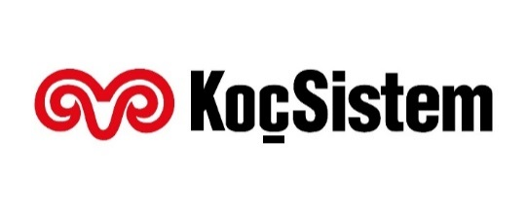


Key outcomes enabled by SM Automation
Automated ticket handling
Intelligent knowledge delivery
Engaging experience
Efficient ticket handling
Proactive
Task automation
Accurate, up-to-date asset information
Improved user experience
Increased staff efficiency
$500,000 savings in asset consolidation
50% first year ROI recovery
Increased change success rate to 99%
Achieved 85% first call resolution
Ticket self-management delivers a 26% reduction in incidents
Better allocation of help desk resources

Slide 8
SMA Components
Machine Learning and Analytics Service Desk
Self Service Portal
Enterprise Service Management
Configuration Management System
Automation

Slide 9
Leading Innovation – Machine Learning and Analytics
End user
Simple and fast submission
Quick answers
Instant help
Superior self-sufficiency
Automatic knowledge delivery
Smart Ticket
IT Agent
Smart suggestions
Intelligent knowledge delivery
24 x 7 service desk availability
Automatic ticket routing
Turn data into actionable insights
Smart Search
End User Chat
Smart Email
Hot Topic Analytics
Notes:
Built on an OEM-licensed version of IDOL, Machine Learning and Analytics drives automation further into ITSM processes by mining unstructured data and by extracting information from different types of data:
Improving the processes of Help Desk management, including ticket management
Improving search experience across a variety of internal and external content to find answers quickly
Reducing the time and effort expended on interaction submittals by end users and IT professionals
Provide 24x7 help desk support via email and bot chat
Accelerating the process of problem management
For end users:
Simple and fast submission ->Improve user satisfaction
Find answers quickly -> Save effort and guess work
Self-sufficiency -> Always on: anytime – 24x7
Automatic knowledge delivery -> Increase user productivity
For IT Agents and Managers:
Smart suggestions -> Quick resolution times
Intelligent knowledge delivery -> Find answers quickly
Automatic ticket routing -> Fast and accurate assignment
Turn data into actionable insights -> Proactively spot hot topics Identify data trends

Slide 10
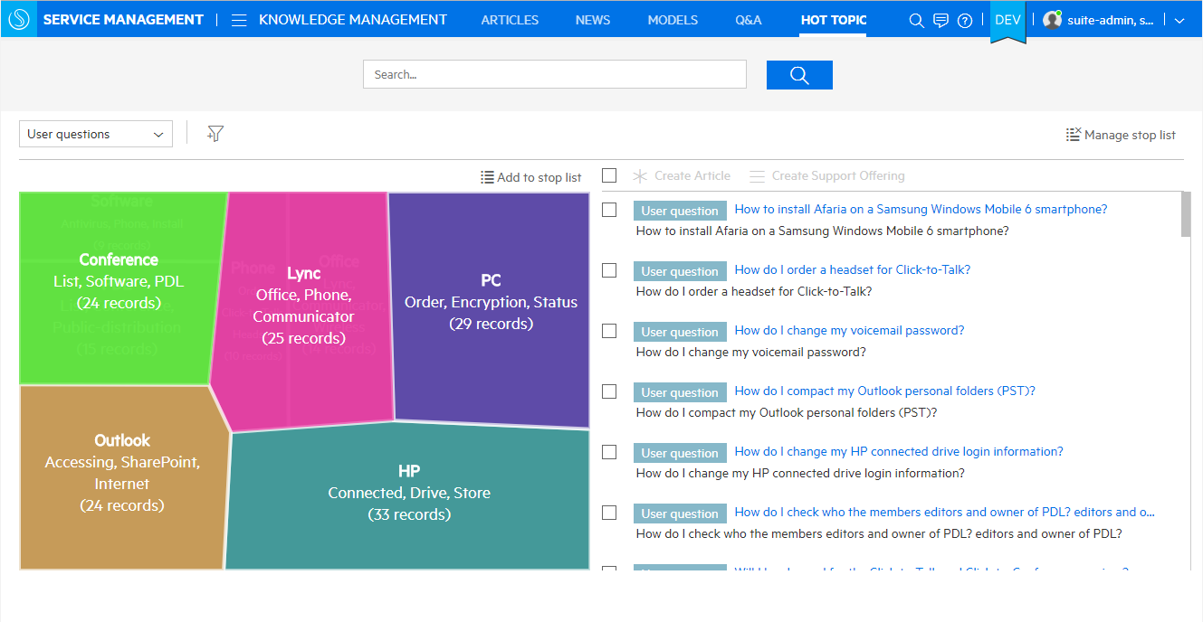
Machine Learning and Analytics Based Service Desk
Hot topic analytics
Search for hot topics
Configure stop word lists
Create
knowledge articles
catalog offerings
problem records
Shows analysis of important interest areas
Displays hot topics and record counts
Notes:
NOTE: Screenshot shows SMAX

Slide 11
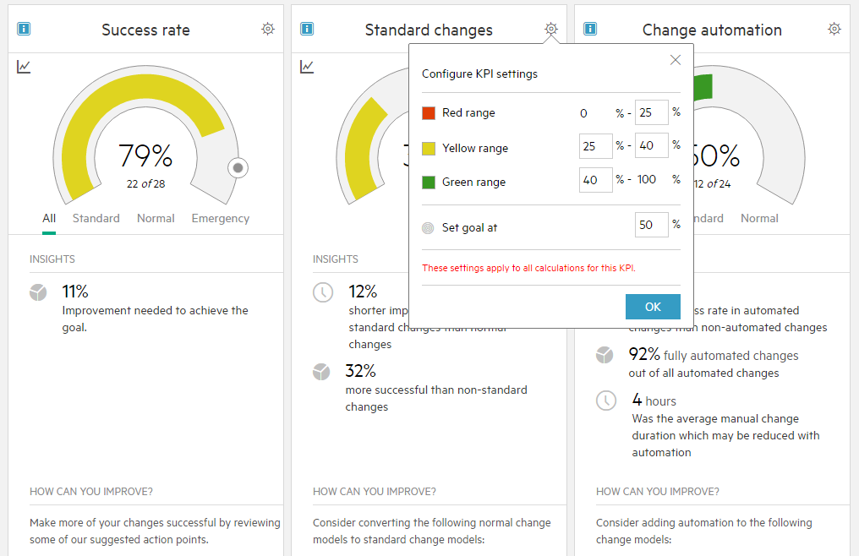
Machine Learning and Analytics Based Service Desk
Change analytics
Predictive analytics change owners to make process improvements
Analytics identify areas that can benefit from standard modeling and automation as means to reduce risk, increase success rates, and reduce implementation times
Insights
Recommended improvements
Notes:
NOTE: Screenshot shows SMAX

Slide 12

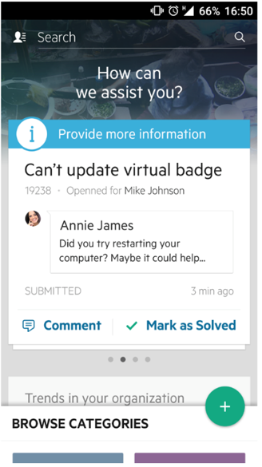
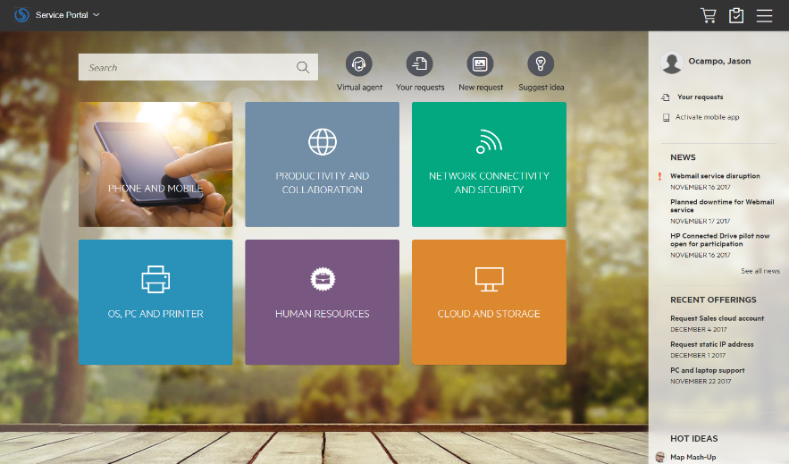
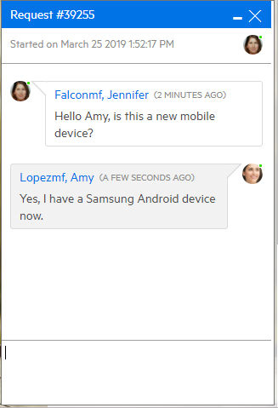
Easy to Use Self-service
Service portal and mobile application
Notifications
Shopping cart
IDOL based search
Catalog offerings
Live or Virtual Agent Chat
Notes:
One of ITSMA key elements is the service portal with capabilities like:
- IDOL based search for news, catalog offerings, knowledge articles.
- Notifications, providing information like the status of a user’s service request
- Shopping Cart, providing an integrated view of all goods and services offered

Slide 13
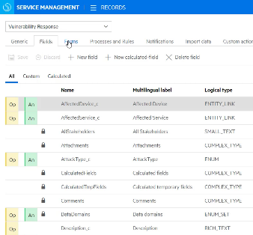
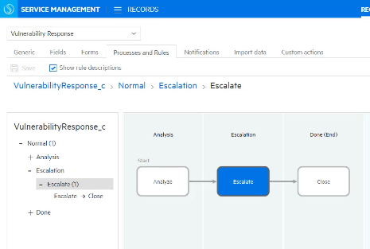
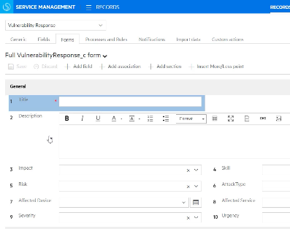
Codeless Configuration and Easy Upgrades
Instant creation and easy upgrade of new service management processes
New process based application
Create app workflow
User defined table
Create form for new app
Notes:
NOTE: Screenshot shows SMAX

Slide 14
Configuration Management Challenges
Lack of visibility to the datacenter HW, SW and dependencies
Unplanned outages and emergency change requests
Time consuming mapping of dependencies
Rapid Changes and DevOps require dynamic update in real-time
Unknown asset usage (SW/HW)
Poor incident and change management
Lack of compliance (License, PCI, NERC etc.)
Out of date or non-existent dependency maps
Inability to perform incident, change, event monitoring in cloud / containers
Overspend on assets or compliance risk
Notes:
Organizations make hundreds to thousands of IT changes per year that might result in IT service failures. Traditional processes now co-exist with DevOps and Continuous Delivery to reduce the risk of change by making many small, incremental changes instead of a few "big bang" changes.
This process is multiplied with the emergence of cloud computing and a desired hybrid (cloud / on-prem) data model in most companies. Traditional CMS practices struggle to keep up in this evolving environment, and the results can drastically hurt an organization by lowering service management quality, increasing the amount of unplanned and emergency changes, and risking software license compliance violations through an inability to discover and maintain up-to-date license information.

Slide 15


Leading Energy Provider Saves Millions Using Micro Focus CMS to power IT Operations Management
Challenge
Result
Improve the management of the configuration of more than 10,000 servers, reduce costs, and improve the quality of services delivered
20% reduction in MTTR to restore service for major incidents
$2M cost savings by improving accuracy of associating server assets
Case Study: Major Energy Provider Saves Millions by Tracking Server Configuration
Notes:
Here is an example of Excelon, one of the largest utility providers in the United States, after they moved to a central CMS model to power ITOM:
20% reduction in MTTR to restore service for major incidents
$2M cost savings by improving accuracy of associating server assets
http://h20195.www2.hpe.com/V2/GetDocument.aspx?docname=4AA6-5508ENW&cc=us&lc=en

Slide 16
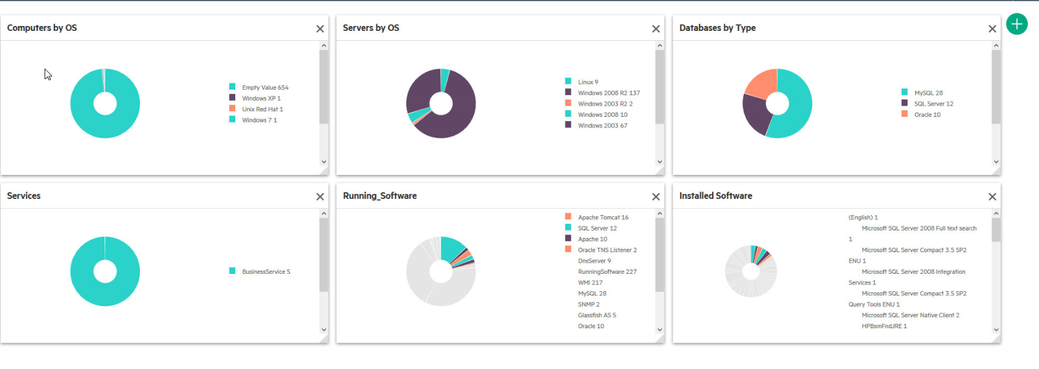
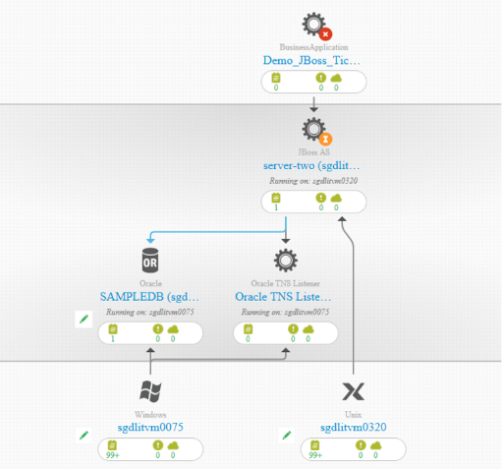
Configuration Management System (CMS)
Industry’s best combination of bottom up and top down discovery and modeling
Intuitive web browser interface Easy access to all CMS data
Automated Discovery Cloud and on premise Top-down and bottoms-up Agent-based, agent-less, hybrid, and passive
Automated service modeling Easy, fast dependency modeling to a top-down model of a business service
Smart Software Analytics
Innovative automated software teaching for software asset management
Notes:
The Configuration Management System (CMS) is a comprehensive set of tools for collecting, storing, managing, updating and presenting data about IT services configuration items (software and infrastructure) and about their relationships.
CMS includes Automated Discovery (Micro Focus Universal Discovery) and a federated configuration management database (Micro Focus Universal CMDB) that integrates with trusted sources in a seamless fashion-allowing IT management teams to make effective decisions and control changes.
Key capabilities include:
- Agile top-down and bottoms-up discovery - agent-based, agent-less, hybrid, and passive
- Automated service modeling for easy, fast dependency modeling to a top-down model of a business service
- Cloud and on premise discovery capabilities
- Both inventory and dependency mapping in a single tool
- Easy access to all CMS data via intuitive web browser interface
- Common platform integration across all ITSM and Operations Analytics tools

Slide 17




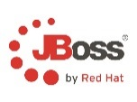



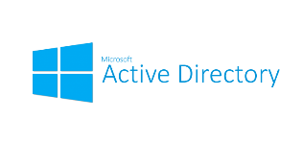




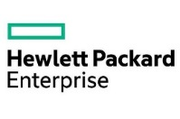


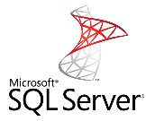

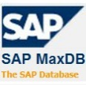

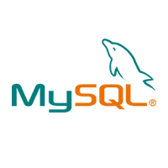
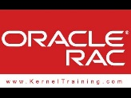

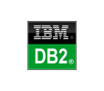
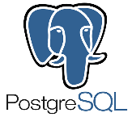

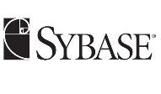

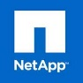




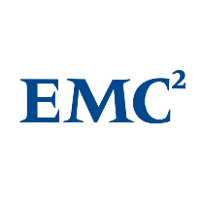











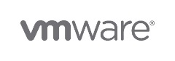

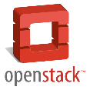
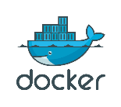




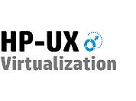














Micro Focus Universal Discovery Capabilities
Applications
Storage Discovery
Storage Discovery
Databases
Clusters & Load Balancers
Network Discovery
Virtualization & Cloud
Inventory & Infrastructure Discovery

Slide 18
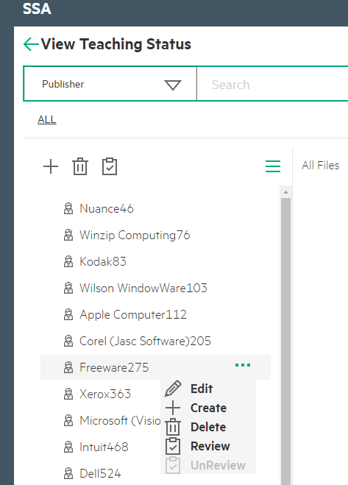
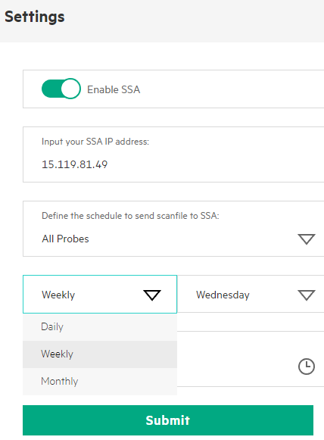
Leading Innovation – Smart Software Analytics
IDOL based automated software teaching
Embedded SAI editor for improved SAI validation experience
Automated generation of user SAI file based on unrecognized software, using IDOL-based Machine Learning
SSA joins and automates the recognition and teaching processes
Recognition Process
UCMDB
Teaching Process
Automated replication of user SAI file to UCMDB and probes
Automated collection and replication of scan files to teaching server
User-configurable scheduling of scan file collection from remote probes
Notes:
Software Asset Management remains a key industry trend and focus, and now the industry-leading IDOL platform for unstructured data search has been added to Universal Discovery. This adds a level of machine learning to software license discovery, providing vastly improved software application index (SAI) maturity within an organization through automated software recognition and teaching. Historically, unknown software has been difficult to add to a company’s application index. This is because the process is manual and must be verified by someone with the most recent software knowledge. Powered by IDOL machine learning, UD can now automatically “fill in the blanks” of missing software title information without manual insertion of information. This capability results in reduced user effort in evaluating new software and turnaround time for software to be recognized, as well as an automatically up-to-date SAI.

Slide 19
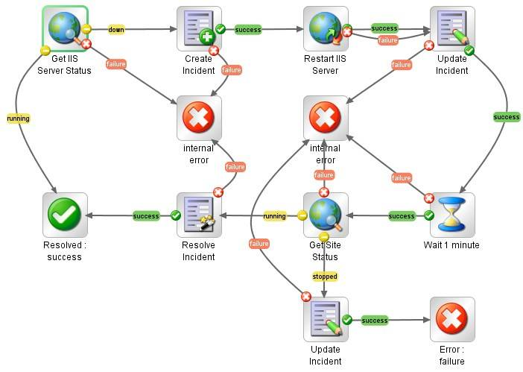
Task automation
Automating standard service deliver and support tasks
Automates the break-fix cycle
Diagnostics and remediation
Change execution and release deployment
Automate change related tasks
Orchestrate change processes
Enables fast request fulfillment
Automate request fulfillment tasks

Slide 20
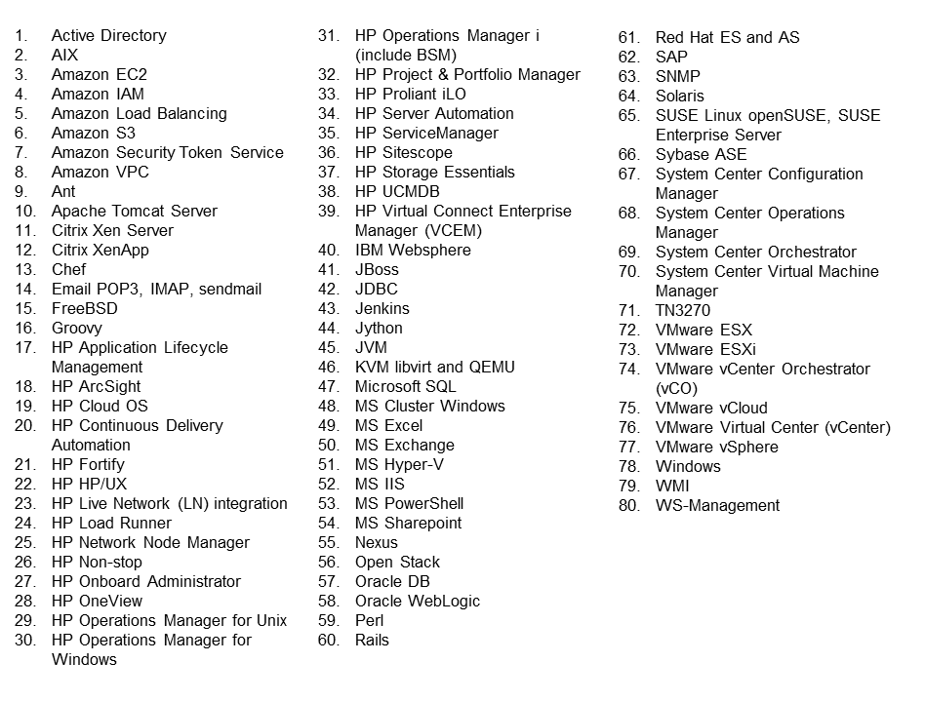
Micro Focus differentiated value—extensive time to value
8000+ flows, 80+ integrations out of box
And more is being added every month by Micro Focus

Slide 21
SMA Suite Editions
2 editions
Add-ons
Delivery options

Slide 22
SMA Suite licensing
SMA-SM Express
5 user pack:
Service Management with Smart Analytics
Universal CMDB
Asset Tracking
SMA-SM Premium
5 user pack:
SMA-SM Express
Asset Management (1 user per pack):
Contract
Financial
Software Installation and License Tracking
Software License Compliance
Service Portal
Machine Learning & Analytics
Service Desk
Change Management
Request Fulfillment
Release Management
Asset Management
Task Automation
Configuration Management System
CMDB and Discovery
SMAX Express
5 user pack:
Service Management with Smart Analytics
Universal CMDB
Asset Tracking
SMAX Premium
5 user pack:
SMAX Express
Asset Management:
Contract
Financial
Software Installation and License Tracking
Idea & Proposal
Application Portfolio
Project & Program
Operations Orchestration nodes
Universal Discovery units
Notes:
CMS Unit-based Licensing (current as of March 2019) sold in 10 Units License Packs:
Advanced Discovery:
Service Dependency + Automated Service Modeling + Oracle LMS
10 Servers OSI
Basic Discovery:
Inventory + Software + Smart Software Analytics
50 Servers OSI
100 workstations
100 Network & storage devices, containers, printers or mobile devices

Slide 23
SMA Suite Deployment Options
 | SMAX | SMA-SM
Classic Deployment |  | with Portal in Container
Container Deployment | CDF *
Public Cloud Deployment | AWS, Azure, *
* Check Support Matrix for additional platform and cloud providers supported

Slide 24
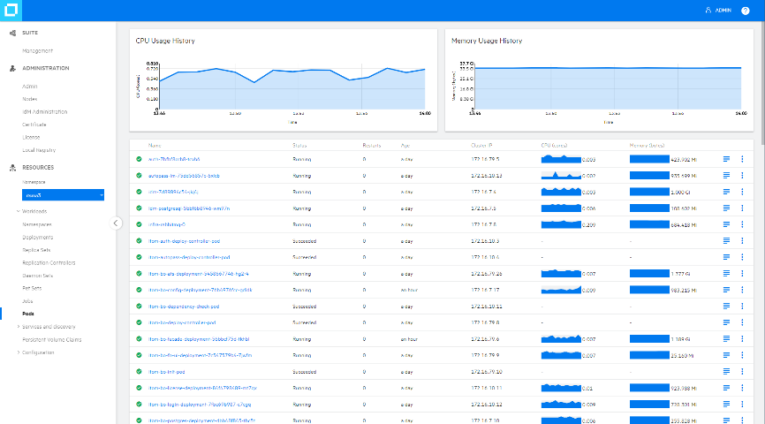
ITOM Platform With Deployment Choice
Quick time to value while minimizing implementation and update effort
Quick installation with pre-integrated containers
Modern UX, REST APIs, Bots
Operations
Orchestration
Configuration
Management and Discovery
Collect Once Store Once
(with Vertica)
Business Value
Dashboards
(Reporting)
ChatOps
Micro Focus Services
(CI/CD, Admin, Login, License)
Ecosystem
Services
(Partner, Third Party, Community)
Update and patch with zero downtime
Container Deployment Foundation
Auto-scaling, self-healing and secure
PHYSICAL
VIRTUAL
CLOUD
CONTAINER
Deployment choice
New functionality available with each quarterly release
Notes:
We believe that a broader view of IT Ops is required. A blending of DevOps and AIOps. And this requires a platform.
Our ITOM Platform is here today. Products don’t sit on top --- They are built into this platform
Providing a modern UX per domain -- Bots -- API’s -- Extensible -- Extend the platform - our partners are already doing this. --- Deploy anywhere
This is the first and only modern IT Ops platform in the industry -- Really unique here -- Integration and Installation times in just a few hours, Updates in a few minutes, Scaling in seconds
Each product suite becomes a set of microservices selected from the overall ITOM Platform.
Built on our Container Deployment Foundation – modular, flexible, scalable
The Container Deployment Foundation touches on 4 areas
Distribution. All of the suites come now with a standard licensing model. Instead of multiple license model we boiled down to one easily manageable license unit. They come up and are all delivered in pre-integrated containers. OOTB, inside the factory we are doing a lot of pre-integration for standard use cases.
Install and update. Suites built with the Container Deployment Foundation are very easy to install. very easy to maintain, with automated updates, and automated patching. And very soon, over the next couple of quarters we will get to the point when we actually expend the capabilities to have a zero downtime, asynchronous updates.
Auto-scaling. Suite deployments can flex in and flex out, so patches, rollbacks, getting bigger, getting smaller, - it will all just happen. And it happens at scale. It will happen within seconds, to expand the footprint of the product, reduce the footprint of the product, very quickly and very easily.
Deploy Anywhere: It is available to be deployed on-premise, in public cloud, in private cloud or on containers. So eventually you will be able to have on-prem, off-prem, in AWS or Azure. MSPs will be able to offer it, it makes it extraordinarily portable.
All of this done on top of an automated and modern orchestration layer built natively to handle container clusters at scale. The Container Deployment Foundation delivers a state-of-the-art container management and orchestration framework leveraging the Docker container architecture and Kubernetes for orchestration. Both CLI and API management is offered as well.
Core services: integrate across IT Ops – to a new level
Operations Orchestration – THE industry standard- 8000+ item content library , HTML5 UI, import content
CMS 11- best large scale UD & UCMDB- HTML5 – Search – Cloud & Containers
ChatOPs – First- security – now including support for MSFT Teams
Collect Once, Store Once (COSO) architecture – Broadest coverage
Business Value Dashboards

Slide 25
Micro Focus SMA Competitive Differentiation
SM Competitors and their positioning
Micro Focus SMA Differentiators

Slide 26



SMA Competition
Replace unstructured work patterns of the past with intelligent workflows of the future. Improve service levels, energize employees, and change the way your enterprise works.
Comprehensive ITIL support with world-class self-service portal.
Codeless design for easy customization and hassle-free upgrades.
Choose from subscription or perpetual concurrent licensing, on-premise or SaaS.
Accelerators of Digital Enterprise Management
Gartner Magic Quadrant Leader again
BMC digital IT powers 82% of the Fortune 500 companies

Slide 27
Micro Focus SMA Differentiation
Superior user experience and increased staff efficiency
Efficiency
Agility
Innovation
Deliver value quickly and easily
ITSM Automation Suite
Faster service, better experience, lower costs
Accelerate delivery and processes.
Container Deployment
Foundation
Optimized for Continuous Operations
Transform the way you work.
Smart Innovation
Machine learning, Flexible, discovery, Container Lifecycle
Find out more at www.microfocus.com/itsm

Slide 28

The Micro Focus CMS Advantage
Superior Discovery
Increased staff efficiency
Agent-based, agent-less, or hybrid discovery in one tool
Automated Service Modeling
Real-time discovery in cloud and containers
Modern, intuitive UI
Advanced private and public cloud discovery
Smart Software Analytics
Notes:
Superior discovery:
Versatile top-down and bottoms-up discovery offering agent-based, agent-less, hybrid and passive discovery in one tool providing maximum flexibility for any configuration goal of dependency or inventory mapping
Cloud-ready discovery: real-time event based discovery ensures environments are always up-to-date, discovery can exist in the cloud, and rich set of native public cloud discovery capabilities
Automated Service Modeling: Easy and fast service modeling using algorithms and application configuration files to top-down model a business service by just entering the URL of the service. High value as it is included with purchase of UD. This drastically reduces the time it takes to map services within an organization (a process that when done manually could take weeks or months)
Machine learning in discovery of software licenses and Oracle-verified license discovery provides high depth of detail of software characteristics on deployed systems and drastically reduces the amount of time spent by st
Modern UI: UCMDB Browser, UCMDB Home, and Probe dashboard greatly simplify CMS administration and onboarding of the product to new users

Slide 29

Congratulations!
You completed the course.
But this is not the end …
What’s next?
Take the Certification Exam!
Go to the Sales Portal and register for the exam.
Pass with a score of 80% or better!
29
Notes:
[STANDARD SLIDE]
Congratulations! You completed the course!
We have covered [short statement].
You should now be able to [short statement that aligns with course objectives].
[PRESS] So what’s next?
[PRESS] Your next step is to take the Certification Exam.
[PRESS TO DISPLAY TEXT AND LINK] Click the link to go to the Sales Portal, find the course, and register for the Certification Exam.
[PRESS] Pass with a score of 80% or better to become certified.

